Slide 1
Design and Analysis of Algorithms
Sorting in linear time (Ch8)

Slide 2
Simple Review
QuickSort
  Divide and Conquer
  PARTITION
  Analysis of QuickSort
    Worst case Θ(n²)
    Expected running time: Θ(n lgn)
  Randomized quicksort
The best worst-case running time for comparison sorting
  Decision-tree Model
  Theorem. Any comparison sorting algorithm requires Ω(n lgn) comparisons in the worst case

Slide 3
Design and Analysis of Algorithms
Sorting in linear time
Topics:
Counting sort
Radix sort
Bucket sort

Slide 4
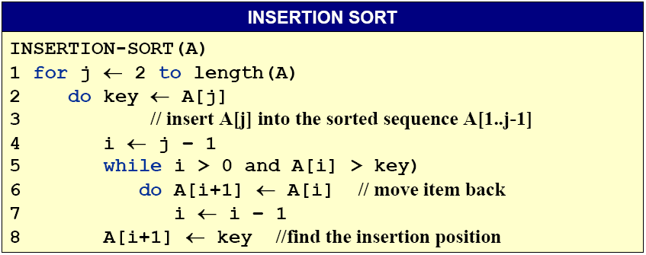
Sorting Lower bound
Is there a faster algorithm?
If different model of computation?

Slide 5
Counting Sort
Counting sort: No comparisons between elements.
  Input: A[1..n], where A[j] ∈{1,2,…,k}
  Output: B[1..n], sorted.
  Auxiliary storage: C[1..k].
For x in A, if there are 17 elements less than x in A, then x belongs in output position 18.
How if several elements in A have the same value?
  Put the 1st in position 18, 2nd in position 19,3rd in position 20,…
How if there are 17 elements not greater than x in A?
  Put the last one in position 17, the penultimate one in position 16,…
Notes:
Penultimate：[pin^ltimit]语尾倒数第二个的, 倒数第二音节的

Slide 6
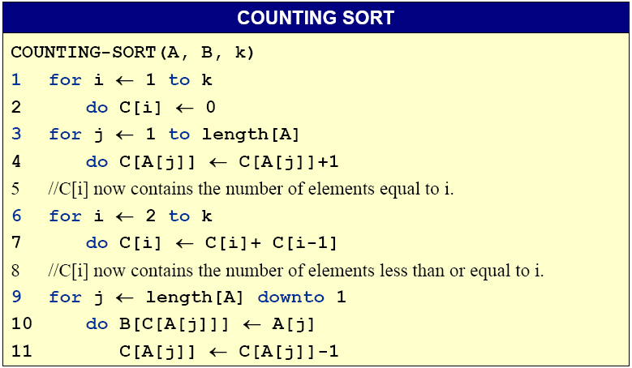
Counting Sort

Slide 7
Counting-sort example
n=5,k=4
1 | 2 | 3 | 4 | 5
1 | 2 | 3 | 4
A:
4 | 1 | 3 | 4 | 3
C:
1 | 2 | 3 | 4 | 5
B:

Slide 8
Counting-sort example
1 | 2 | 3 | 4 | 5
1 | 2 | 3 | 4
A:
4 | 1 | 3 | 4 | 3
C:
1 | 2 | 3 | 4 | 5
B:

Slide 9
Counting-sort example
1 | 2 | 3 | 4 | 5
1 | 2 | 3 | 4
A:
4 | 1 | 3 | 4 | 3
C:
0 | 0 | 0 | 0
1 | 2 | 3 | 4 | 5
B:

Slide 10
Counting-sort example
1 | 2 | 3 | 4 | 5
1 | 2 | 3 | 4
A:
4 | 1 | 3 | 4 | 3
C:
0 | 0 | 0 | 0
1 | 2 | 3 | 4 | 5
B:

Slide 11
Counting-sort example
1 | 2 | 3 | 4 | 5
1 | 2 | 3 | 4
4
1
3
4
3
0
0
0
1
A:
C:
0
1 | 2 | 3 | 4 | 5
B:

Slide 12
Counting-sort example
1 | 2 | 3 | 4 | 5
1 | 2 | 3 | 4
4
1
3
4
3
0
0
0
A:
C:
1
1
1 | 2 | 3 | 4 | 5
B:

Slide 13
Counting-sort example
1 | 2 | 3 | 4 | 5
1 | 2 | 3 | 4
4
1
3
4
3
1
0
0
A:
C:
1
1
1 | 2 | 3 | 4 | 5
B:

Slide 14
Counting-sort example
1 | 2 | 3 | 4 | 5
1 | 2 | 3 | 4
4
1
3
4
3
1
0
1
2
A:
C:
1
1 | 2 | 3 | 4 | 5
B:

Slide 15
Counting-sort example
1 | 2 | 3 | 4 | 5
1 | 2 | 3 | 4
4
1
3
4
3
1
0
1
A:
C:
2
2
1 | 2 | 3 | 4 | 5
B:

Slide 16
Counting-sort example
1 | 2 | 3 | 4 | 5
1 | 2 | 3 | 4
4
1
3
4
3
1
0
1
A:
C:
2
2
1 | 2 | 3 | 4 | 5
B:

Slide 17
Counting-sort example
1 | 2 | 3 | 4 | 5
1 | 2 | 3 | 4
4
1
3
4
3
1
0
2
A:
C:
0
2
1 | 2 | 3 | 4 | 5
B:

Slide 18
Counting-sort example
1 | 2 | 3 | 4 | 5
1 | 2 | 3 | 4
4
1
3
4
3
1
0
2
A:
C:
1
2
1 | 2 | 3 | 4 | 5
B:

Slide 19
Counting-sort example
1 | 2 | 3 | 4 | 5
1 | 2 | 3 | 4
4
1
3
4
3
1
1
2
A:
C:
3
2
1 | 2 | 3 | 4 | 5
B:

Slide 20
Counting-sort example
1 | 2 | 3 | 4 | 5
1 | 2 | 3 | 4
4
1
3
4
3
1
1
3
5
A:
C:
2
1 | 2 | 3 | 4 | 5
B:

Slide 21
Counting-sort example
1 | 2 | 3 | 4 | 5
1 | 2 | 3 | 4
4
1
3
4
3
1
1
1
A:
C:
3
5
1 | 2 | 3 | 4 | 5
B:

Slide 22
Counting-sort example
1 | 2 | 3 | 4 | 5
1 | 2 | 3 | 4
4
1
3
4
3
1
1
1
A:
C:
3
5
1 | 2 | 3 | 4 | 5
B:

Slide 23
Counting-sort example
1 | 2 | 3 | 4 | 5
1 | 2 | 3 | 4
4
1
3
4
3
1
1
3
A:
C:
3
5
1 | 2 | 3 | 4 | 5
B:
3

Slide 24
Counting-sort example
1 | 2 | 3 | 4 | 5
1 | 2 | 3 | 4
4
1
3
4
3
1
1
2
A:
C:
3
5
1 | 2 | 3 | 4 | 5
B:
3

Slide 25
Counting-sort example
1 | 2 | 3 | 4 | 5
1 | 2 | 3 | 4
4
1
3
4
3
1
1
1
A:
C:
2
5
1 | 2 | 3 | 4 | 5
B:
3

Slide 26
Counting-sort example
1 | 2 | 3 | 4 | 5
1 | 2 | 3 | 4
4
1
3
4
3
1
1
2
5
A:
C:
5
1 | 2 | 3 | 4 | 5
B:
3
4

Slide 27
Counting-sort example
1 | 2 | 3 | 4 | 5
1 | 2 | 3 | 4
4
1
3
4
3
1
1
2
4
A:
C:
5
1 | 2 | 3 | 4 | 5
B:
3
4

Slide 28
Counting-sort example
1 | 2 | 3 | 4 | 5
1 | 2 | 3 | 4
4
1
3
4
3
1
1
1
A:
C:
2
4
1 | 2 | 3 | 4 | 5
B:
3
4

Slide 29
Counting-sort example
1 | 2 | 3 | 4 | 5
1 | 2 | 3 | 4
4
1
3
4
3
1
1
2
A:
C:
2
4
1 | 2 | 3 | 4 | 5
B:
3
3
4

Slide 30
Counting-sort example
1 | 2 | 3 | 4 | 5
1 | 2 | 3 | 4
4
1
3
4
3
1
1
1
A:
C:
2
4
1 | 2 | 3 | 4 | 5
B:
3
3
4

Slide 31
Counting-sort example
1 | 2 | 3 | 4 | 5
1 | 2 | 3 | 4
4
1
3
4
3
1
1
1
A:
C:
1
4
1 | 2 | 3 | 4 | 5
B:
3
3
4

Slide 32
Counting-sort example
1 | 2 | 3 | 4 | 5
1 | 2 | 3 | 4
4
1
3
4
3
1
A:
C:
1
1
1
4
1 | 2 | 3 | 4 | 5
B:
1
3
3
4

Slide 33
Counting-sort example
1 | 2 | 3 | 4 | 5
1 | 2 | 3 | 4
4
1
3
4
3
0
A:
C:
1
1
1
4
1 | 2 | 3 | 4 | 5
B:
1
3
3
4

Slide 34
Counting-sort example
1 | 2 | 3 | 4 | 5
1 | 2 | 3 | 4
4
1
3
4
3
0
1
1
A:
C:
1
4
1 | 2 | 3 | 4 | 5
B:
1
3
3
4

Slide 35
Counting-sort example
1 | 2 | 3 | 4 | 5
1 | 2 | 3 | 4
4
1
3
4
3
0
1
1
4
A:
C:
4
1 | 2 | 3 | 4 | 5
B:
1
3
3
4
4

Slide 36
Counting-sort example
1 | 2 | 3 | 4 | 5
1 | 2 | 3 | 4
4
A:
4
1
3
4
3
C:
0
1
1
3
1 | 2 | 3 | 4 | 5
B:
1
3
3
4
4

Slide 37
Counting-sort example
1 | 2 | 3 | 4 | 5
1 | 2 | 3 | 4
4
1
3
4
3
0
1
1
A:
C:
1
3
1 | 2 | 3 | 4 | 5
B:
1
3
3
4
4

Slide 38
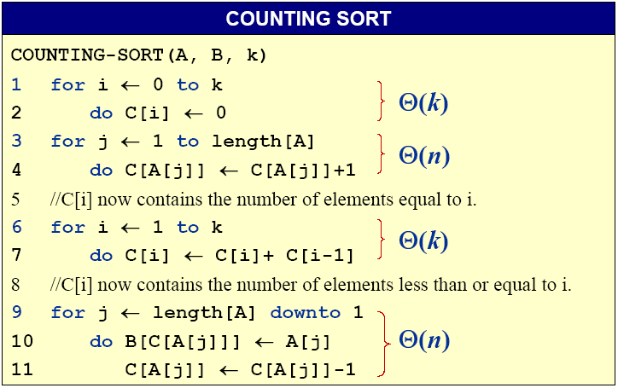
Analysis of Counting Sort
Θ(k)
Θ(n)
Θ(k)
Θ(n)
The overall time is Θ(k+n)

Slide 39
Running time
If k = O(n), then counting sort takes Θ(n) time.
--But, sorting takes Ω(n lgn) time!
--Where’s the fallacy?
Answer:
--Comparison sorting takes Ω(n lgn) time.
--Counting sort is not a comparison sort.
-- In fact, not a single comparison between elements occurs!
Notes:
fallacy：谬误, 谬论

Slide 40
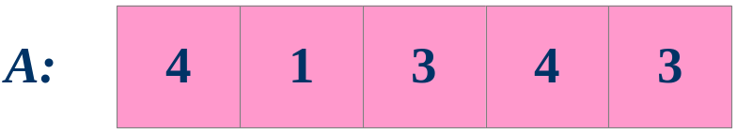
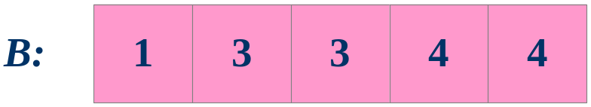
Stable sorting
Counting sort is a stable sort: it preserves the input order among equal elements.
Exercise: Where other sorts have this property?

Slide 41
Radix sort
Origin: Herman Hollerith’s card-sorting machine for the 1890 U.S. Census.
Digit-by-digit sort.
Hollerith’s original (bad) idea: sort on most-significant digit first.
Good idea: Sort on least-significant digit first with auxiliary stable sort.
Notes:
Census：人口普查

Slide 42
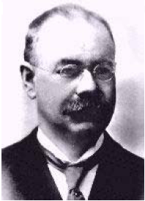
Herman Hollerith (1860-1929)
The 1880 U.S. Census took almost
10 years to process.
While a lecturer at MIT, Hollerith
prototyped punched-card technology.
His machines, including a “card sorter,” allowed the 1890 census total to be reported in 6 weeks.
He founded the Tabulating Machine Company in 1911, which merged with other companies in 1924 to form International Business Machines.
Notes:
Tabulate：把...制成表格，列表

Slide 43
Operation of radix sort
3
4
6
8
4
7
3
2
5
5
3
3
2
5
9
7
7
9
6
0
5
9
7
7
9
6
0
5
7
3
4
4
6
3
8
2
5
3
5
5
2
3
0
5
6
7
7
9
9
Stable
sort

Slide 44
Operation of radix sort
3
4
6
8
4
7
3
2
5
5
3
3
2
5
9
7
7
9
6
0
5
9
7
7
9
6
0
5
7
3
4
4
6
3
8
2
5
3
5
5
2
3
2
5
3
5
5
2
3
0
5
6
7
7
9
9
7
3
4
8
3
4
6
2
2
3
3
5
5
5
0
9
6
9
5
7
7
Stable
sort
Stable
sort

Slide 45
Operation of radix sort
3
4
6
8
4
7
3
2
5
5
3
3
2
5
9
7
7
9
6
0
5
9
7
7
9
6
0
5
7
3
4
4
6
3
8
2
5
3
5
5
2
3
2
5
3
5
5
2
3
0
5
6
7
7
9
9
7
3
4
8
3
4
6
7
3
4
8
3
4
6
2
2
3
3
5
5
5
0
9
6
9
5
7
7
3
3
4
4
6
7
8
2
5
3
5
5
2
3
9
5
6
7
7
0
9
Stable
sort
Stable
sort
Stable
sort

Slide 46
Operation of radix sort-correctness
7
3
4
8
3
4
6
2
2
3
3
5
5
5
0
9
6
9
5
7
7
3
3
4
4
6
7
8
2
5
3
5
5
2
3
9
5
6
7
7
0
9
Induction on digit position
Assume that the numbers are sorted by their low-order t – 1 digits.
Stable
sort
Sort on digit t

Slide 47
Operation of radix sort-correctness
7
3
4
8
3
4
6
2
2
3
3
5
5
5
0
9
6
9
5
7
7
3
3
4
4
6
7
8
2
5
3
5
5
2
3
9
5
6
7
7
0
9
Induction on digit position
Assume that the numbers are sorted by their low-order t – 1 digits.
Stable
sort
Sort on digit t
Two numbers that differ in digit t are correctly sorted.

Slide 48
Operation of radix sort-correctness
7
3
4
8
3
4
6
2
2
3
3
5
5
5
0
9
6
9
5
7
7
3
3
4
4
6
7
8
2
5
3
5
5
2
3
9
5
6
7
7
0
9
Induction on digit position
Assume that the numbers are sorted by their low-order t – 1 digits.
Stable
sort
Sort on digit t
Two numbers that differ in digit t are correctly sorted.
Two numbers equal in digit t are put in the same order as the input → correct order

Slide 49
RADIX-SORT
RADIX-SORT
RADIX-SORT( A , d ) 1 for i ← 1 to d 2 do use a stable sort to sort array A on digit i
Θ(d T(n)), if we use counting sort and d is constant, Θ(n)
LSD：sorting numbers on their Least Significant Digit first.
How if we use MSD：sorting numbers on their Most Significant Digit first?

Slide 50
Bucket Sort
Like counting sort, bucket sort is fast because it assumes something about the input. Whereas counting sort assumes that the input consists of integers in a small range, bucket sort assumes that the input is generated by a random process that distributes elements uniformly.
Idea of Bucket Sort
-- Divide the interval [0,1) into n equal-sized subintervals, or bucket, and then distribute the n input number into the buckets.

Slide 51

Bucket Sort
Assume that all the input is generated by a random process that distributes elements uniform over the interval [0,1)
Bucket sort
-- ① Allocate a bucket for each value of the key
>> That is, insert A[i] into list B[ n A[i] ]
-- ② For each bucket
>> sort list B[ i ] with insertion sort
-- ③ concatenate the list B[0], B[1],…,B[n - 1] together in order
Notes:
[kənˈkætəneɪt]

Slide 52
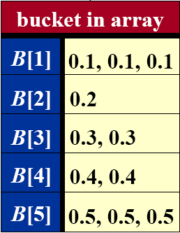
Bucket Sort Example
A=(0.5, 0.1,0.3,0.4,0.3,0.2,0.1,0.5,0.4,0.5)
Sorted list:
0.1, 0.1, 0.2, 0.3, 0.3, 0.4, 0.4, 0.5, 0.5, 0.5

Slide 53
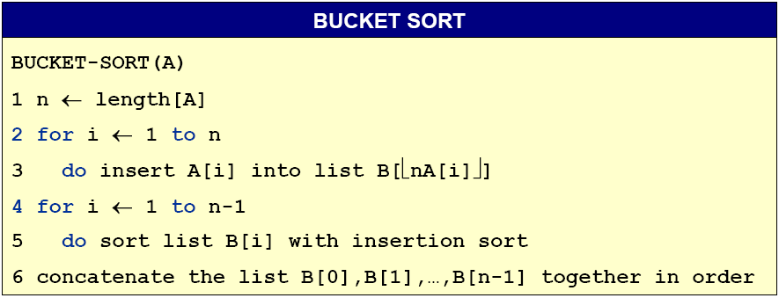
Bucket Sort Algorithm
0

Slide 54

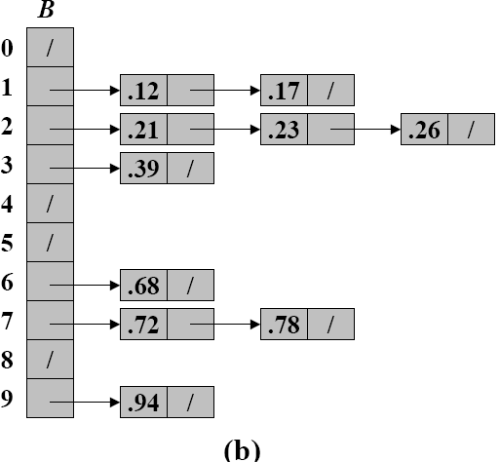
Another Example
(a) The input array A[1..10]
(b) The array B[0..9] of sorted lists (buckets) after line 5 of the algorithm. Bucket i holds values in the half-open interval [i / 10, (i + 1) /10)

Slide 55
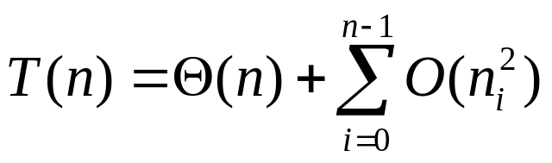
Algorithm Analysis
Θ(n)
under uniform distribution
0
All lines except line 5 take O(n) time in the worst case. Total time to examine all buckets in line 5 is O(n), without the sorting time.
To analyze sorting time, let n_{i} be a random variable denoting the number of elements placed in bucket B[i]. The total time to sort is

Slide 56
Summary of sorting algorithms
Sorting methods | Worst Case | Best Case | Average Case | Application
Insert Sort | n² | n | n² | Very fast when n<50
Bubble Sort | n² | n | n² | Very fast when n<50
Merge Sort | n lgn | n lgn | n lgn | Need extra space; good for external sort
Heap Sort | n lgn | n lgn | n lgn | Good for real-time app.
Quick Sort | n² | n lgn | n lgn | Practical and fast
Counting Sort | k+n | k+n | k+n | Small, fixed range; Need extra space
Radix Sort | d(k+n) | d(k+n) | d(k+n) | Fixed range; Need extra space
Bucket Sort | n | n | n | Uniform distribution
Which in place?
Which stable?
Notes:
外部排序指待排序文件较大，内存一次存放不下，尚需存放在外部介质的文件的排序。

Slide 57
Homework
8.2-1

